Slide 1

Business Analytics II (BIS 244 – Chapter 4)
Part 2
BIS 244 – Fall 2022 – Dr. Davoodi

Slide 2

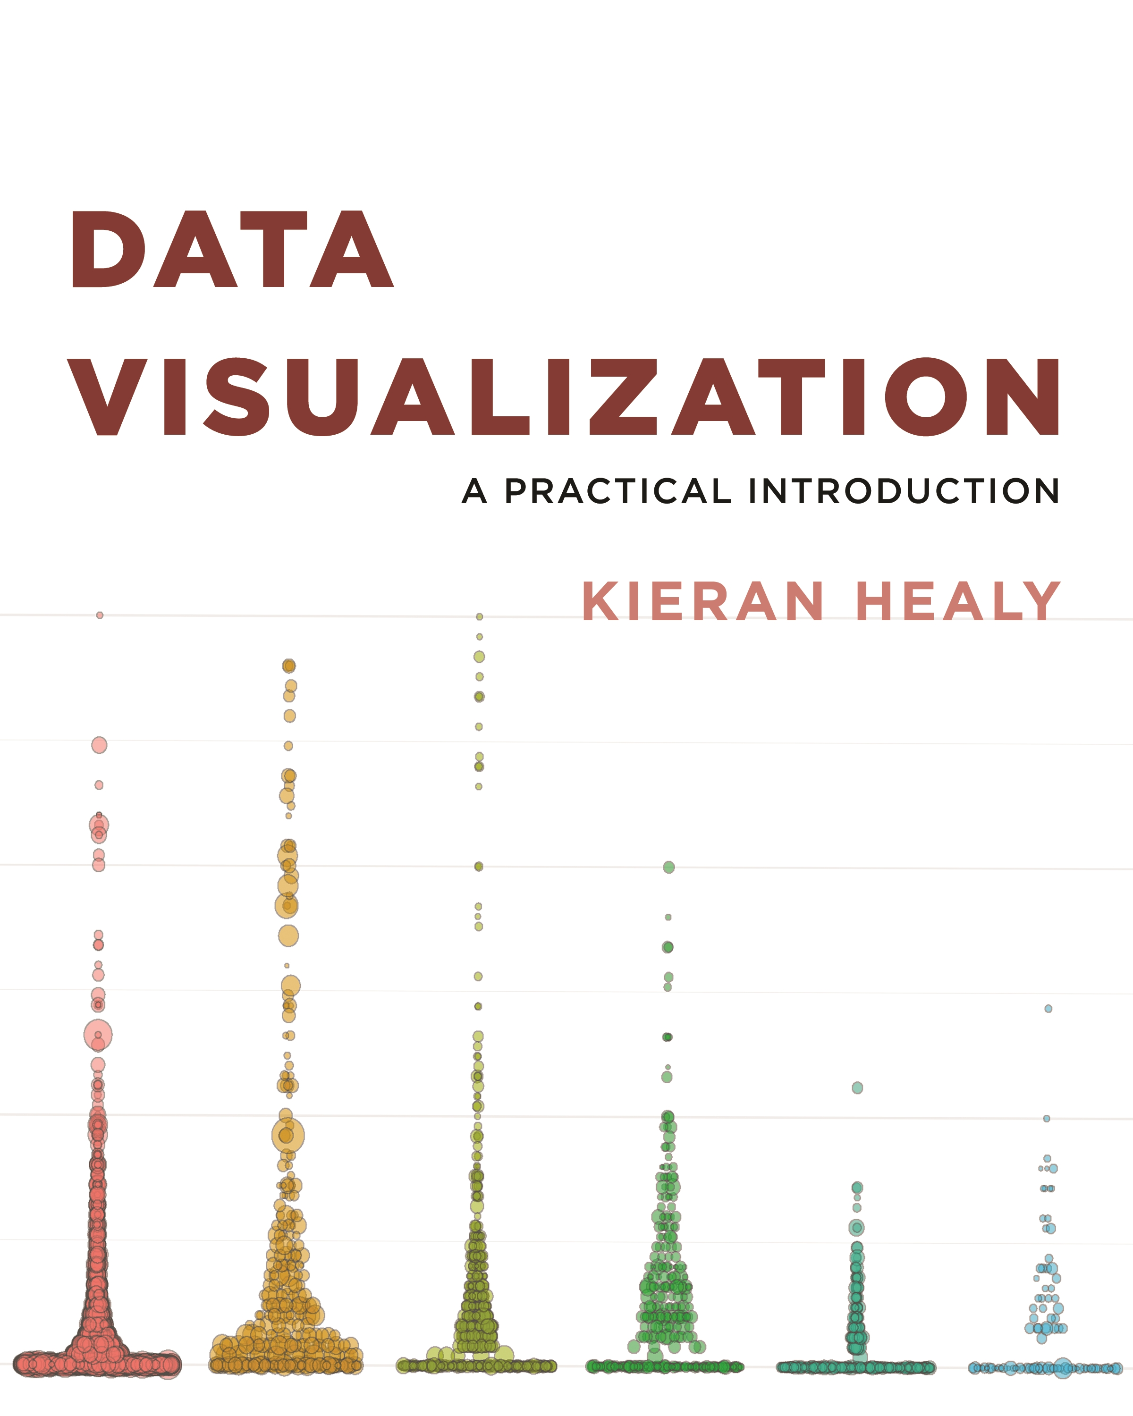
Chapter 4: Show the Right Numbers (Part 2)

Slide 3
Chapter 4
Chapter 4 focus: expanding the range of things you can do with ggplot.
Learn how to make new kinds of graphs.
Learn some new “geoms”, the functions that make particular kinds of plots.
Chapter 4 Part 1:
Dividing data techniques
Chapter 4 Part 2:
Grouping data techniques

Slide 4
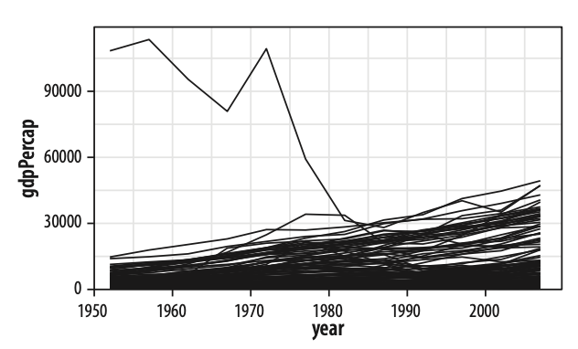
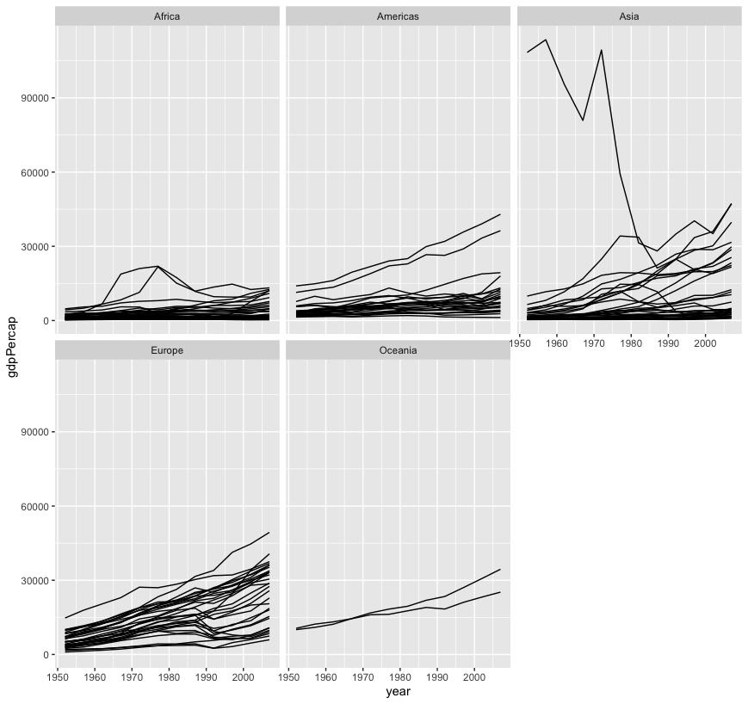
Chapter 4 Review
“gdpPercap” Faceting by continent.
While the overall trend is more or less clear, it looks a little messy.
One option is to facet the data by some third variable, making a “small multiple” plot.
This is a powerful technique that allows a lot of information to be presented compactly and in a consistently comparable way.

Slide 5
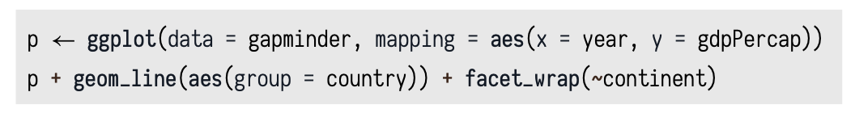
Chapter 4 Review
Facet to Make Small Multiples: Split a plot into a matrix of panels
What is facet in ggplot?
The facet approach partitions a plot into a matrix of panels.
Each panel shows a different subset of the data.
We will use facet_wrap() to split our plot by the third variable.

Slide 6
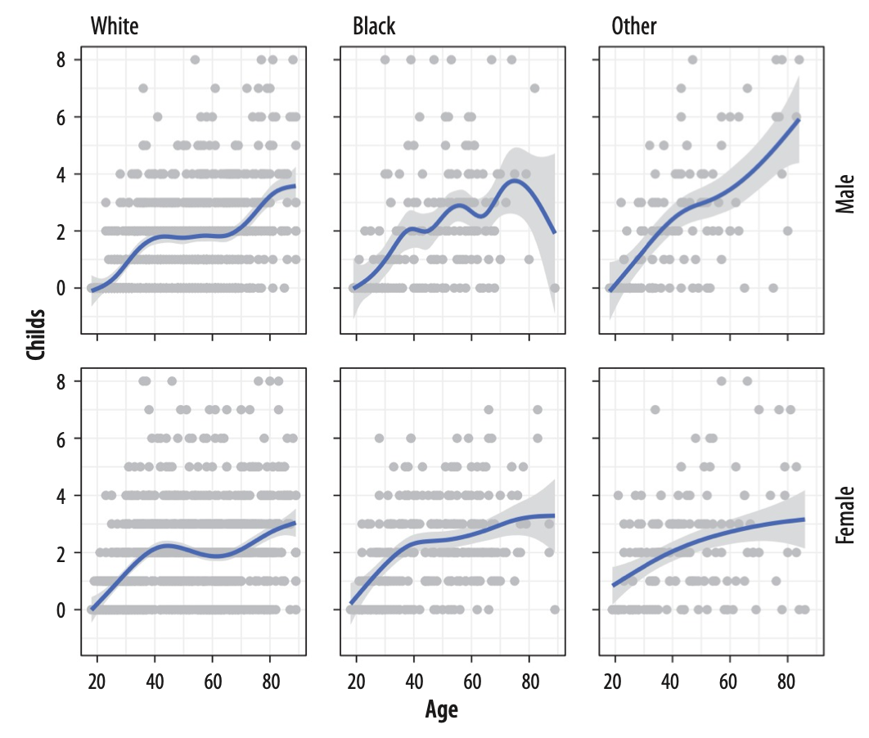
Chapter 4 Review
facet_grid()
facet_grid(): Facet with two variables
By facet_grid(), we are cross-classifying our results.
The formula is two-sided: facet_grid(variable1 ~ variable2).
Faceting on two categorical variables.
Each panel plots the relationship between age and number of children, with the facets breaking out the data by sex (in the rows) and race (in the columns).
Main variables: Age and Number of children
Faceting variables: Sex (row) and Race (column)

Slide 7
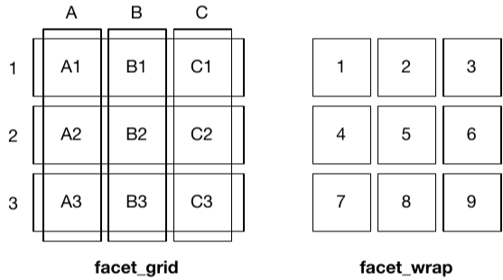
Chapter 4 Review
facet_wrap() Vs. facet_grid()
A sketch illustrating the difference between the two faceting systems.
facet_grid() is fundamentally 2d, being made up of two independent components.
facet_wrap() is 1d but wrapped into 2d to save space.
One independent variable
Two independent variables

Slide 8
4.4 Geoms Can Transform Data
Every geom_ function has an associated statistical function (stat_) that it uses by default.
In this section, we will learn about geom_ function and its related stat_ function.
Also, we will learn what we can do if we sometimes want to calculate a different statistic for the geom from the default.

Slide 9
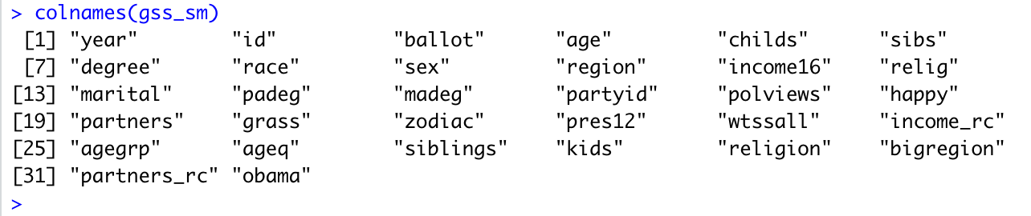
4.4 Geoms Can Transform Data
Example:
Let’s first review “gss_sm” dataset from “gapminder” library.
It has some continuous and some categorical data.
**gss: General Social Survey

Slide 10
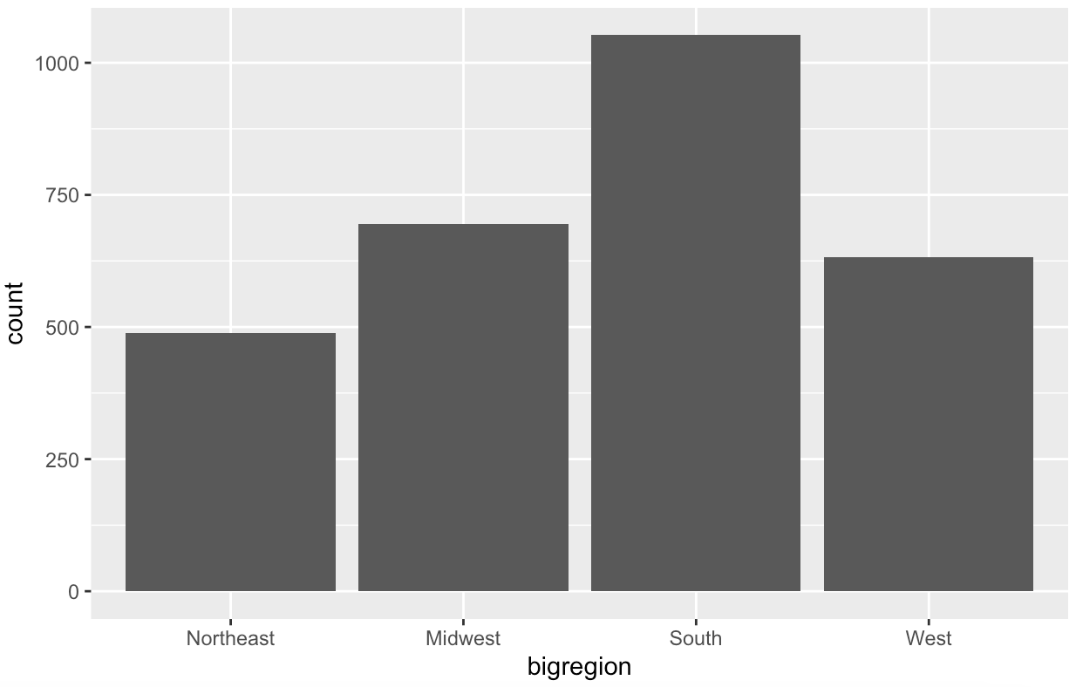
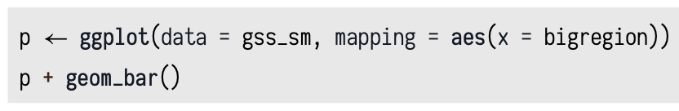
4.4 Geoms Can Transform Data
Healy_CH4_Part2.R
Example (Cont.):
Using geom_bar() for categorical variable “bigregion”:
The bar chart produced gives us a count of the number of (individual) observations in the data set by region of the United States.
The count statistic is the one geom_bar() uses by default.
geom_bar()
stat_count()

Slide 11
4.4 Geoms Can Transform Data
What if we want to use “Relative Frequencies” instead of “count”?
If we want a chart of relative frequencies rather than counts, we will need to get the prop statistic instead.
When ggplot calculates the count or the proportion, it returns temporary variables that we can use as mappings in our plots. The relevant statistic is called ..prop.. .
To make sure these temporary variables won’t be confused with others we are working with, their names begin and end with two periods.
So our calls to it from the aes() function will generically look like this:
<mapping> = <..statistic..>
In this case, we want y to use the calculated proportion, so we say aes(y = ..prop..).

Slide 12
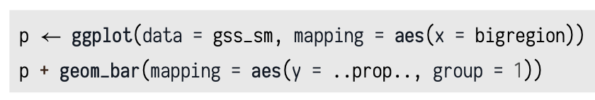
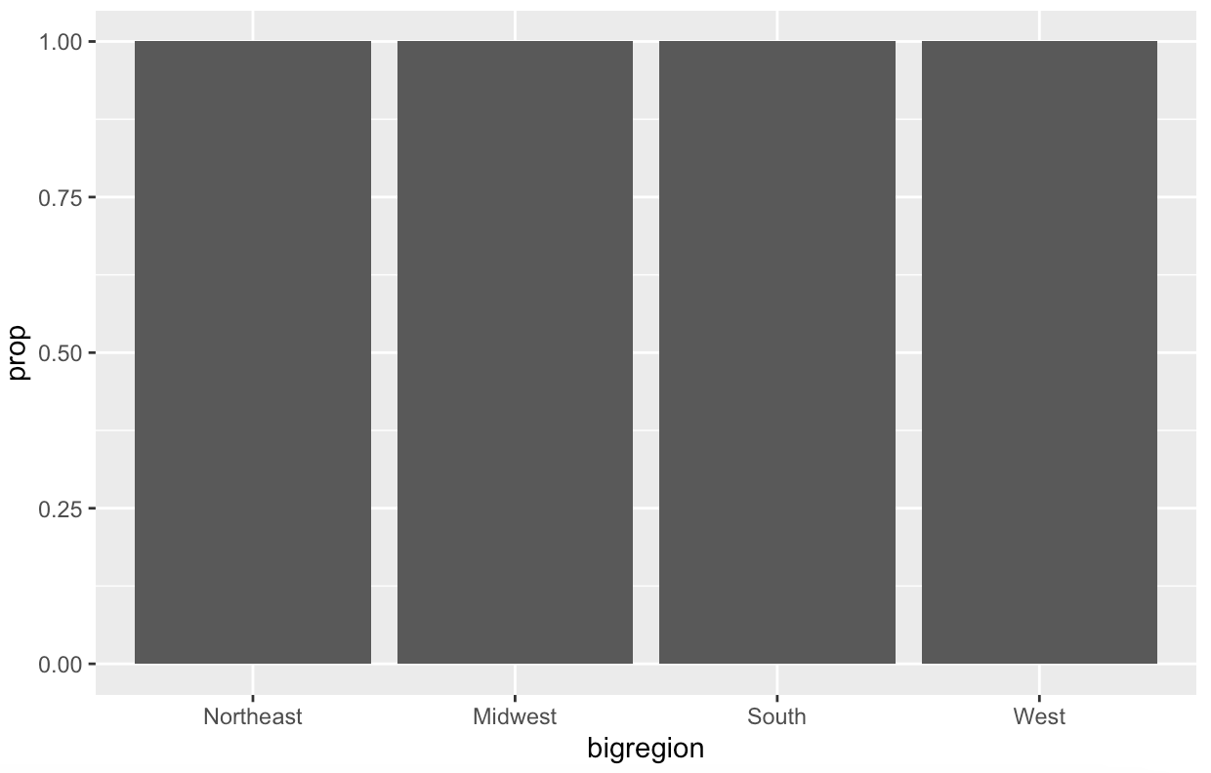
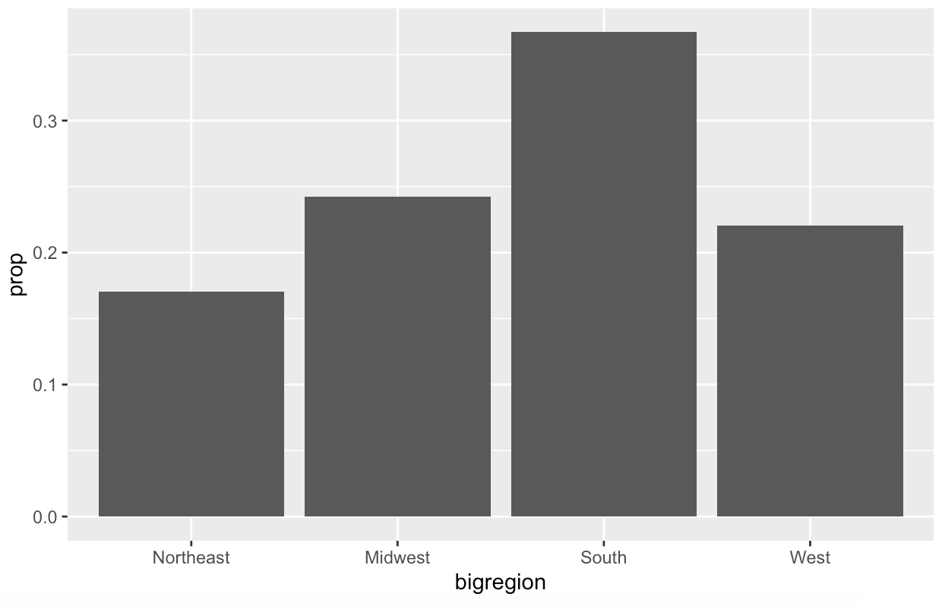

4.4 Geoms Can Transform Data
Healy_CH4_Part2.R
Example (Cont.):
..prop.. defaults to the proportion of each x "group"
When we are calculating denominator of the proportion and use the total number observations instead.

Slide 13
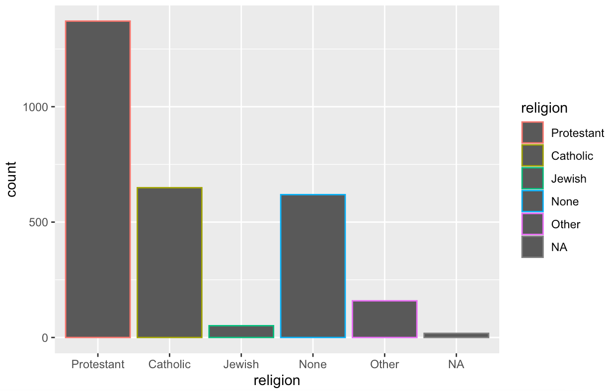
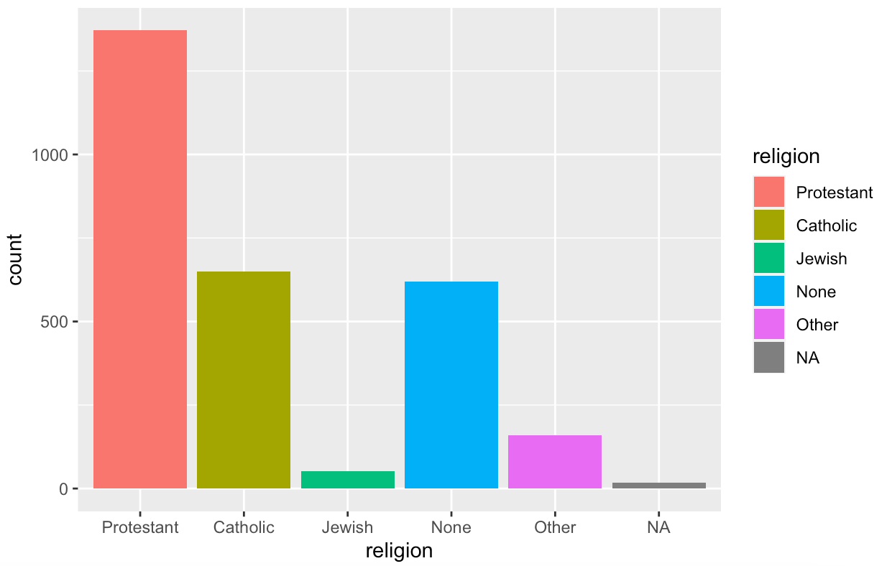
4.4 Geoms Can Transform Data
Healy_CH4_Part2.R
Example 2:
To graph this, we want a bar chart with religion on the x axis (as a categorical variable), and with the bars in the chart also colored by religion.
Legend?
The gss_sm data contains a religion variable derived from a question asking:
“What is your religious preference? Is it Protestant, Catholic, Jewish, some other religion, or no religion?”

Slide 14
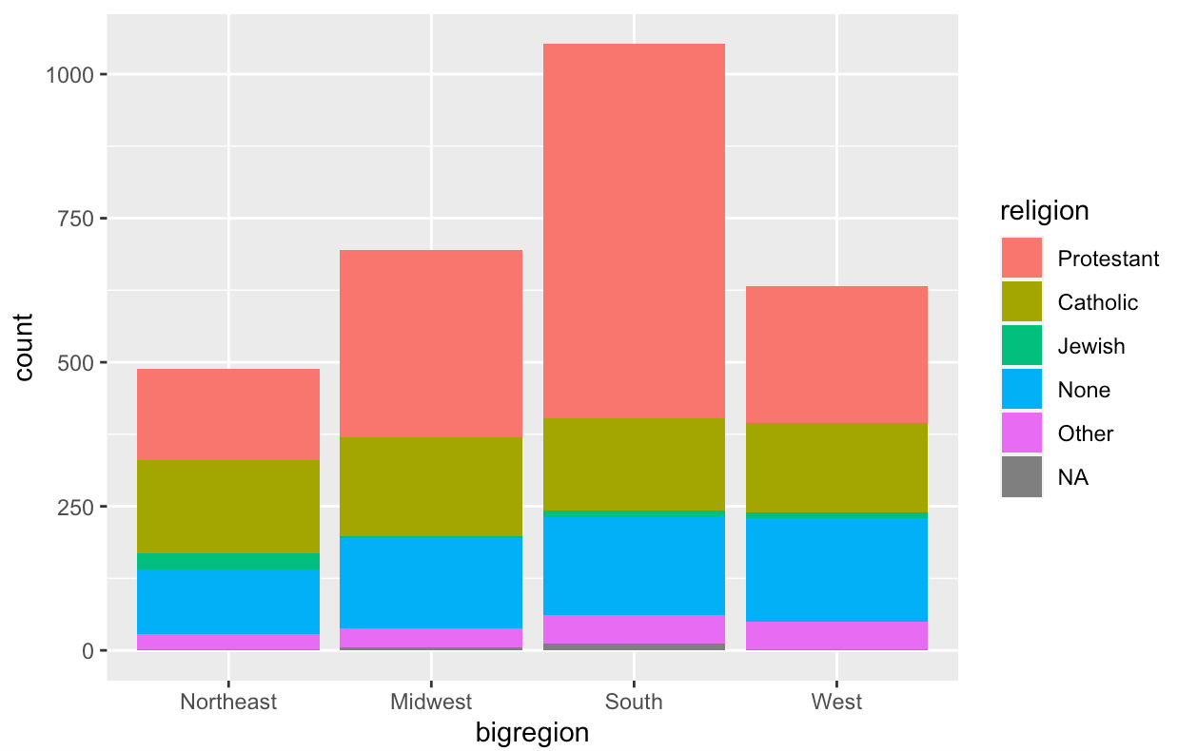
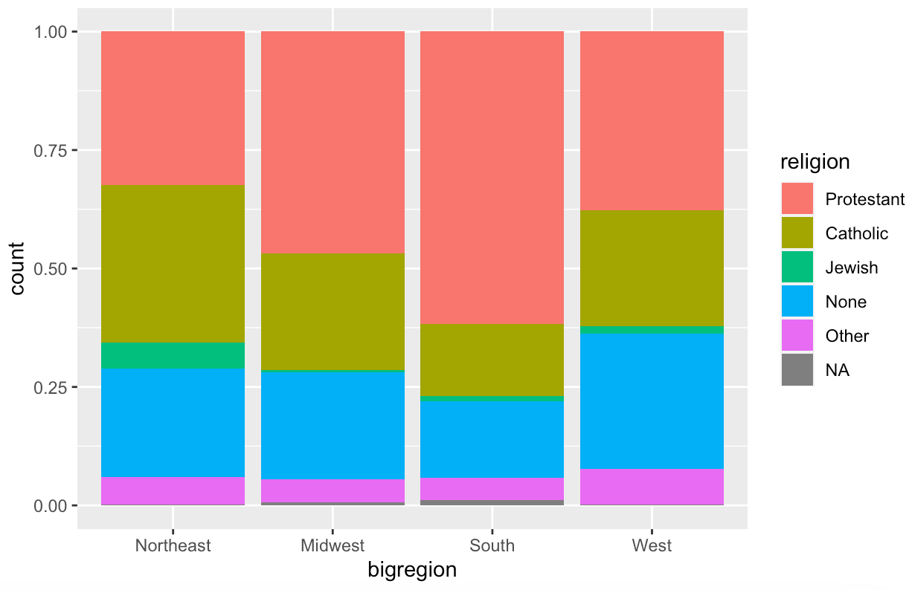
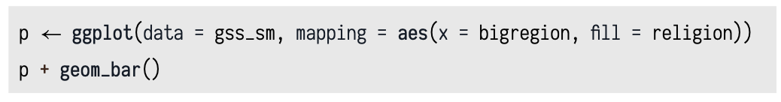
4.5 Frequency Plots the Slightly Awkward Way
A more appropriate use of the fill aesthetic with geom_bar() is to cross-classify two categorical variables.
This is the graphical equivalent of a frequency table of counts or proportions.
It is somewhat difficult for readers of the chart to compare lengths and areas on an unaligned scale.
Default: x = bigregion, fill=religion
But we lose the ability to see the relative size of each cut with respect to the overall total.
Healy_CH4_Part2.R

Slide 15
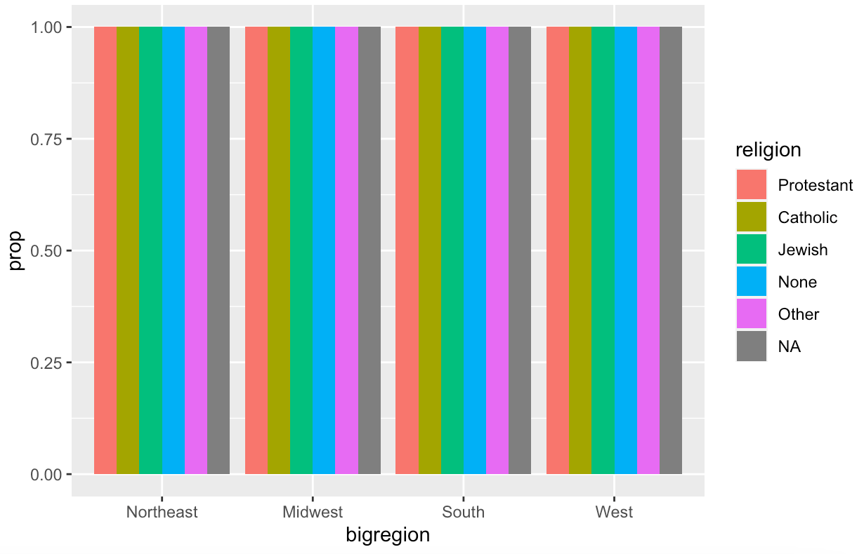
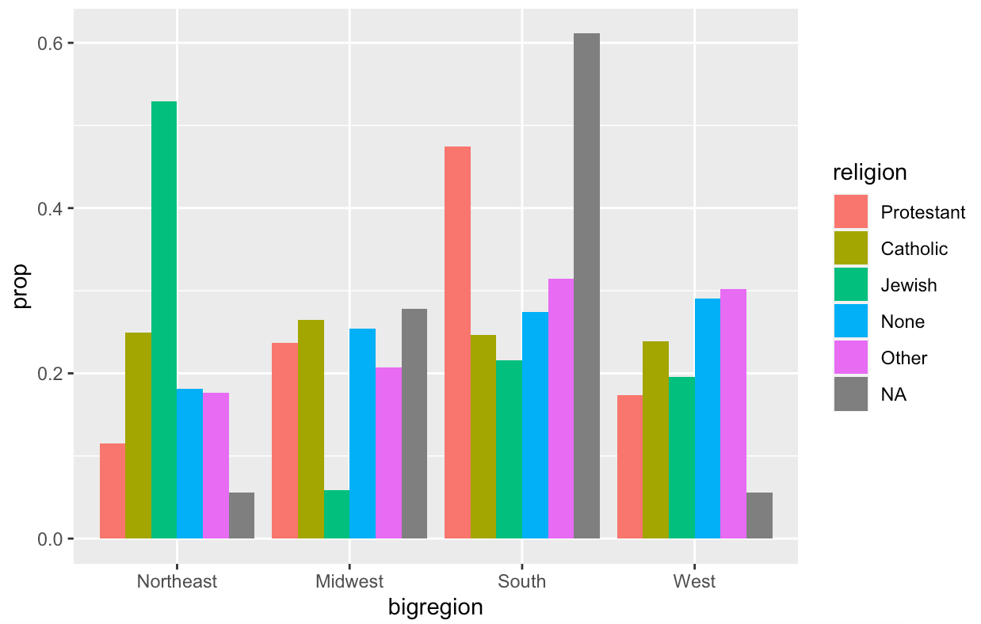
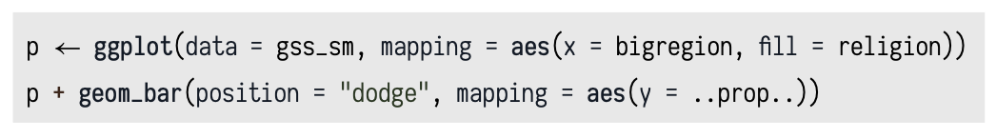
4.5 Frequency Plots the Slightly Awkward Way
If we want bars by religion in each bigregion, use "dodge"
When we just wanted the overall proportions for one variable, we mapped group = 1 to tell ggplot to calculate the proportions with respect to the overall N.
Healy_CH4_Part2.R

Slide 16
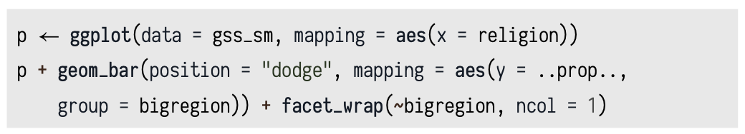
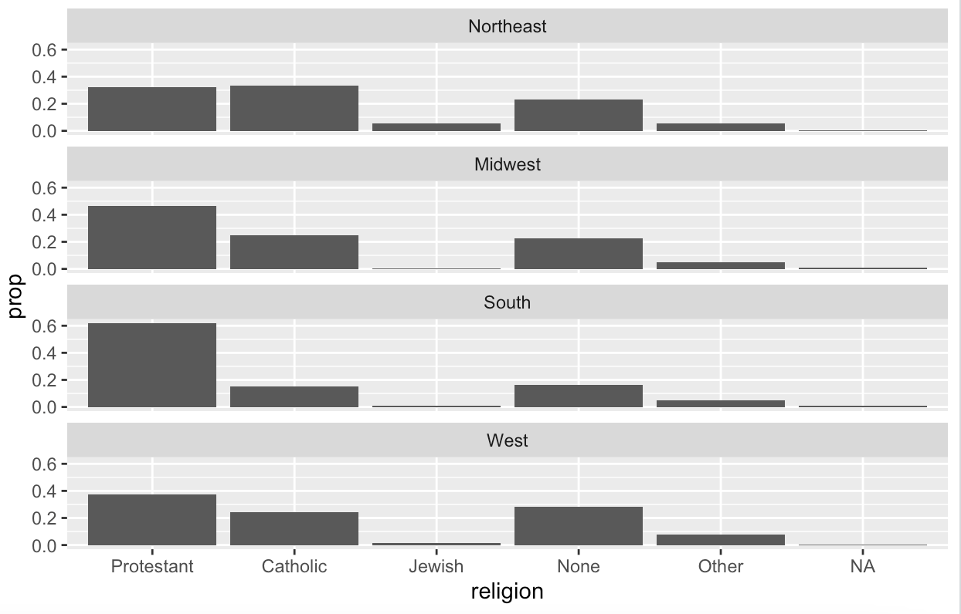
4.5 Frequency Plots the Slightly Awkward Way
Use a combination of grouping and faceting to improve readability of our plot:
We can ask ggplot to give us a proportional bar chart of religious affiliation and then facet that by region.
Notes:
We could polish this plot further, but for the moment we will stop here.
When constructing frequency plots directly in ggplot, it is easy to get stuck in a cycle of not quite getting the marginal comparison that you want, and more or less randomly poking at the mappings to try to stumble on the right breakdown.
In the next chapter, we will learn how to use the tidyverse’s dplyr library to produce the tables we want before we try to plot them.
This is a more reliable approach, and easier to check for errors. It will also give us tools that can be used for many more tasks than producing summaries.

Slide 17
4.6 Histograms and Density Plots
A histogram is a way of summarizing a continuous variable by chopping it up into segments or “bins” and counting how many observations are found within each bin.
Bar chart Vs. Histogram:
In a bar chart, the categories are given to us going in (e.g., regions of the country, or religious affiliation).
With a histogram, we have to decide how finely to bin the data.

Slide 18
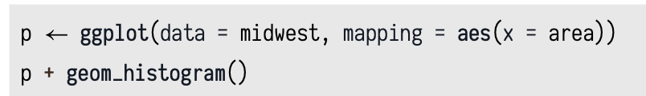
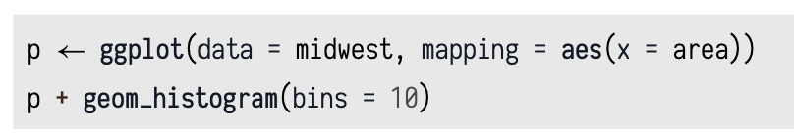
4.6 Histograms and Density Plots
Example:
Healy_CH4_Part2.R
stat_bin() function picked 30 bins, but we might want to try something else:

Slide 19
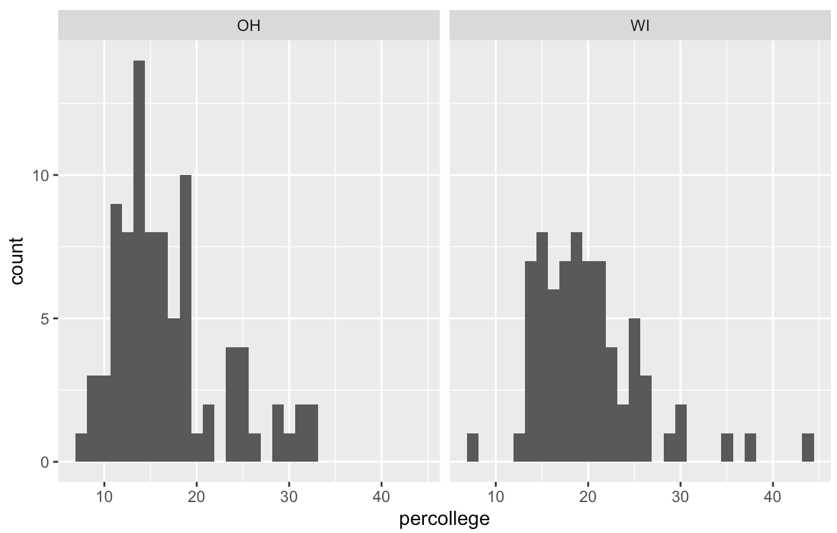
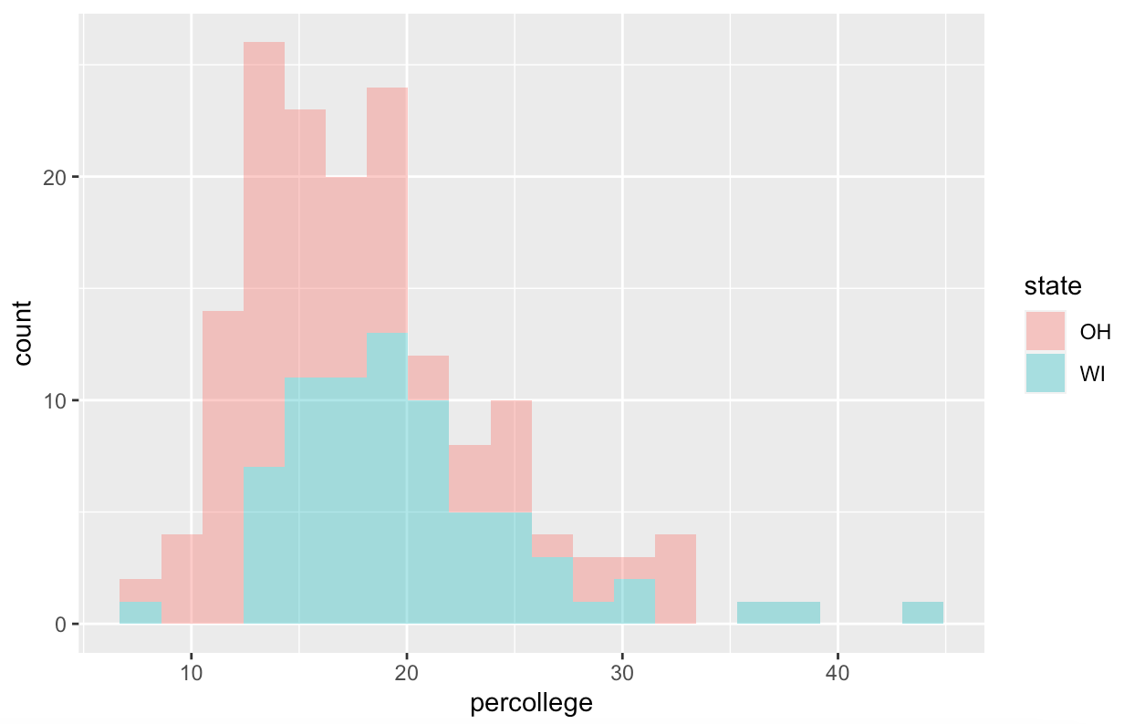
4.6 Histograms and Density Plots
Healy_CH4_Part2.R
While histograms summarize single variables, it’s also possible to use several at once to compare distributions.
We can facet histograms (Panel 1) by some variable of interest, or we can compare them in the same plot (Panel 2) using the fill mapping.
Panel 1
Panel 2
Notes:
The %in% operator is a convenient way to filter on more than one term in a variable when using subset().

Slide 20
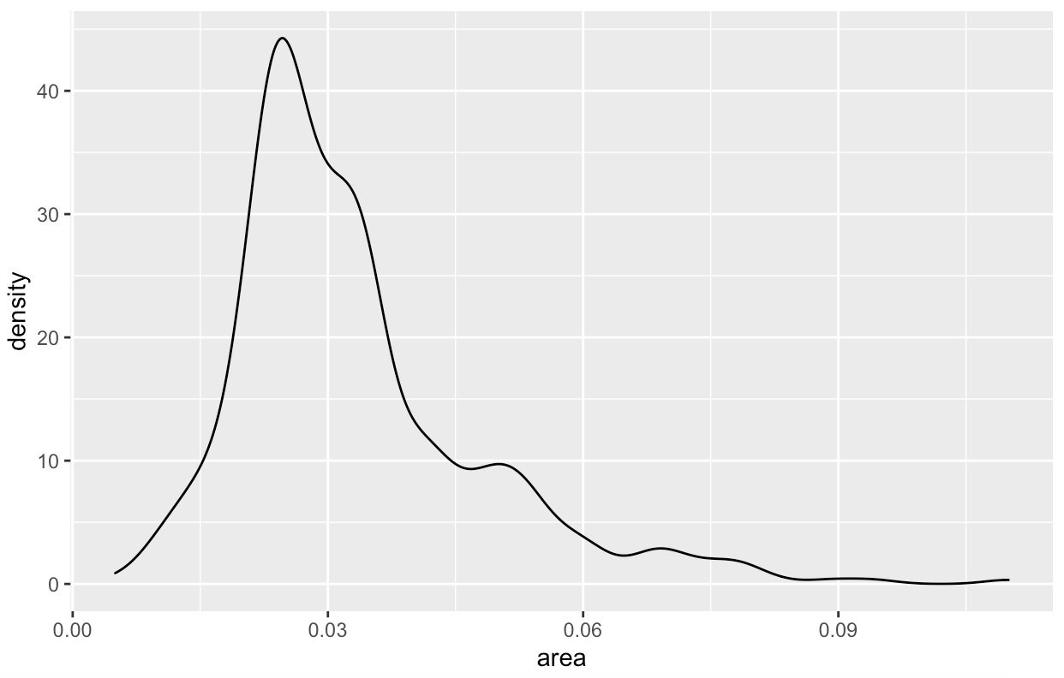
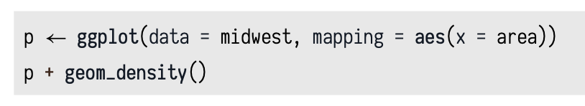
4.6 Histograms and Density Plots
Healy_CH4_Part2.R
When working with a continuous variable, an alternative to binning the data and making a histogram is to calculate a kernel density estimate of the underlying distribution.
The geom_density() function will do this for us.
The density statistic is the one geom_density() uses by default.
geom_density()
stat_density()
Note: If you want to make the baselines of the density curves go away, you can use geom_line(stat = "density") instead.

Slide 21
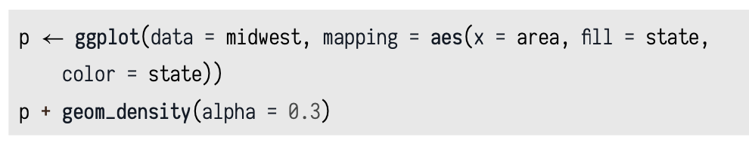
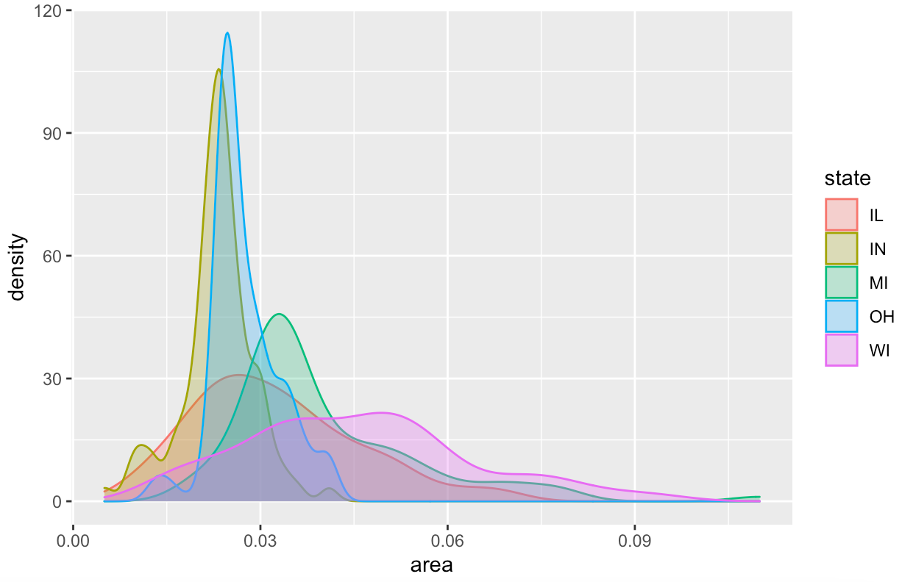
4.6 Histograms and Density Plots
Healy_CH4_Part2.R
Using the fill aesthetic
Note:
Alpha refers to the opacity of a geom.
Values of alpha range from 0 to 1, with lower values corresponding to more transparent colors.

Slide 22
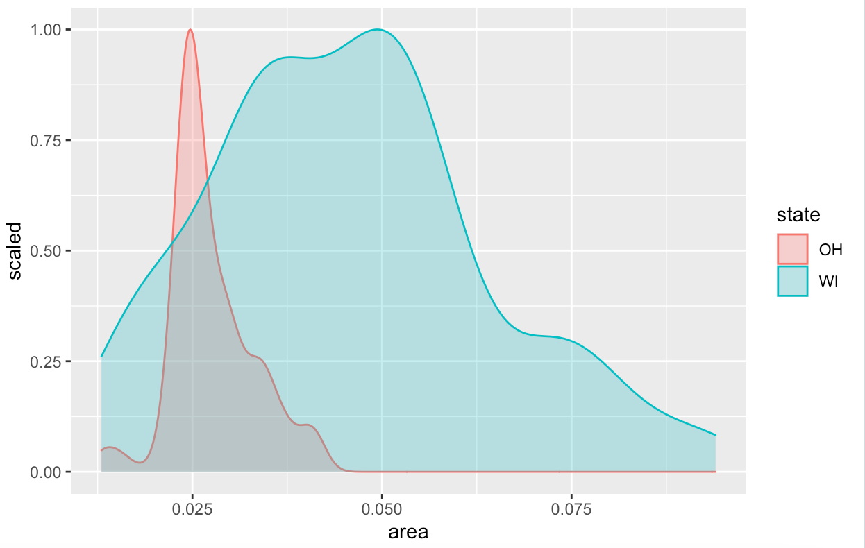
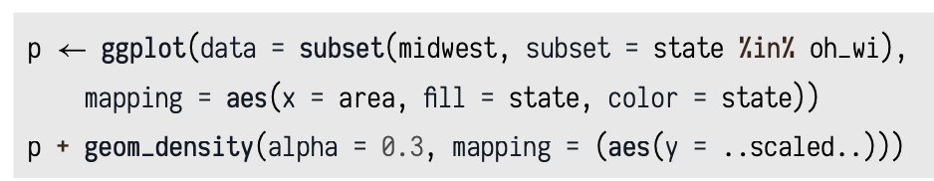
4.6 Histograms and Density Plots
Healy_CH4_Part2.R
Just like geom_bar(), the count-based defaults computed by the stat_ functions used by geom_histogram() and geom_ density() will return proportional measures if we ask them.
For geom_density(), the stat_density() function can return its default ..density.. statistic, or ..scaled.., which will give a proportional density estimate.

Slide 23
4.7 Avoid Transformations When Necessary
As we have seen from the beginning, ggplot normally makes its charts starting from a full dataset.
But often our data is already a summary table.
Because we are working directly a summary table, we no longer have any need for ggplot to count up values for us or perform any other calculations.
That is, we do not need the services of any stat_ functions that geom_bar() would normally call.
To do this we say stat = "identity" in the geom_bar() call.
geom_col() is like geom_bar(), but with an assumed stat = "identity".

Slide 24
Summary
In chapter 4, we learned how to use ggplot functions to divide or/and group data in a plot.
Faceting techniques
Grouping techniques
These techniques will help us to have a better understanding of the plotted data.

